Slide 1
Project: Design a YouTube video classifier
Input: YouTube link
https://www.youtube.com/watch?v=Fc1yN6uxZfQ
Output:
Which topic does this video belongs to?
business
entertainment
politics
technology

Slide 2
Project: Design a YouTube video classifier
Question 1:
What if the summary of the video exceeds 4096 tokens?

Slide 3
Project: Design a YouTube video classifier
Question 2:
Please write the formula for the following metrics:
Accuracy =
Recall =
Precision =
FPR =
F1 score =
 |  | Prediction
 |  | Positive (P) | Negative(N)
Ground truth | Positive (P) | TP | FN
 | Negative (N) | FP | TN

Slide 4
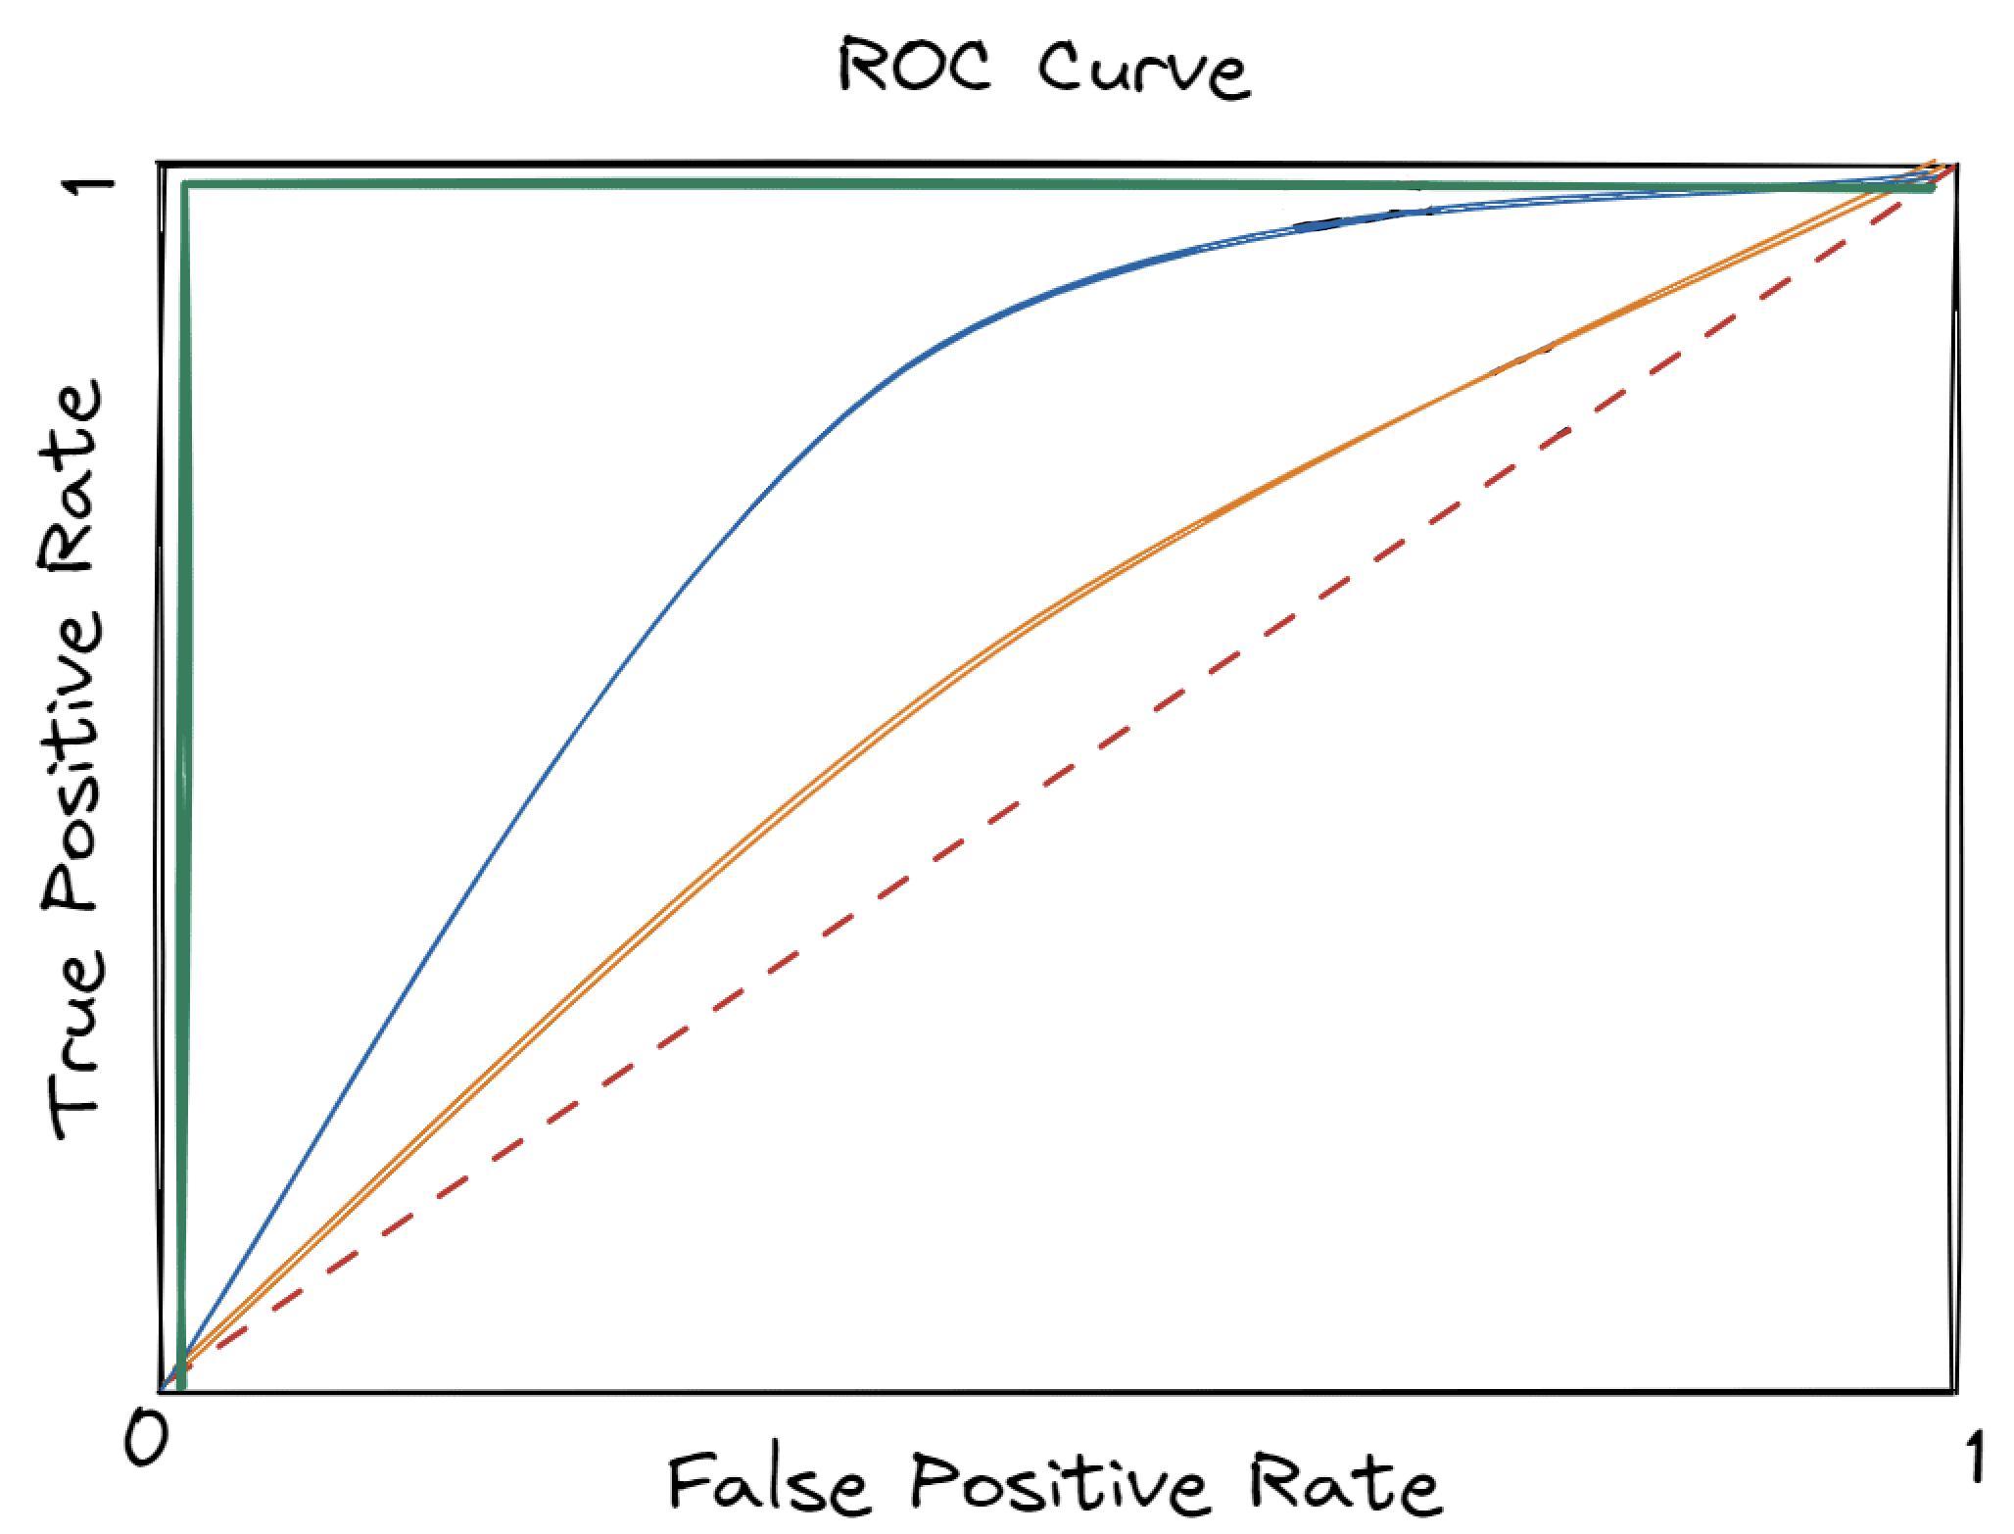
Question 3:
Please compare these four curves.

Slide 5
Project: Design a YouTube video classifier
GitHub: https://github.com/kz2024/project
Input:
498 video summaries labelled with:
“business”, “entertainment”, “politics”, “technology”
2024-01-21_data.json
Task:
Train four binary classifiers with BERT

Slide 6
Project: Design a YouTube video classifier
Question 4:
If the number of video collected on each topic is imbalanced, how to mitigate this issue?
Question 5:
If the total number of dataset is limited, how to mitigate the risk of overfitting?

